Slide 1
CSD-G17 Lip Reading Using deep learning Models
PIP4004 University Project-II
Final Review
14th May 2025
Batch Number:
Under the Supervision of,
Prof. Lakshmisha SK
Assistant Professor
School of Computer Science and Engineering
Presidency University
Roll Number | Student Name
20211CSD0097 | Mohammed Dhayan Ahmed
20211LSD0004 | Srivatsa H
20211CSD0056 | Bavith Raj

Slide 2
Abstract
Lip reading is a crucial aspect of speech recognition technology, aiding individuals with hearing impairments. This project explores deep learning techniques, utilizing CNNs and RNNs for feature extraction and sequence modeling, enhancing accuracy in real-time applications.
This project explores a deep learning-based approach for lip reading, leveraging Convolutional Neural Networks (CNNs) for spatial feature extraction and Recurrent Neural Networks (RNNs), such as Long Short-Term Memory (LSTM) and Transformers, for temporal sequence modeling. The proposed end-to-end model aims to improve lip-reading accuracy by learning robust visual representations from large-scale datasets such as GRID and Lip Reading in the Wild (LRW).

Slide 3
Literature Survey
Visual Attention
Proposes a Transformer-based approach for lip reading, leveraging self-attention mechanisms for
feature extraction.
Introduces a Visual Transformer Pooling module to enhance spatiotemporal representations.
Source: arXiv: 2110.07603
2. Audio Conditioned Diffusion Models for Lip-Synchronization
Uses a diffusion-based generative model to reconstruct lip movements based on audio input.
Implements adversarial training and SyncNet-based loss for better synchronization.
Source: arXiv: 2308.09716
3. Speech-Driven Lip-Sync Model with CNN and LSTM
Combines CNNs for feature extraction and LSTMs for sequence modeling.
Uses DeepSpeech for extracting audio features and mapping them to lip movements.
Source: arXiv: 2205.00916

Slide 4
Literature Survey
4.Lip Reading Sentences in the Wild
Introduces a dual-attention mechanism to integrate audio and visual inputs effectively.
Trains using curriculum learning and scheduled sampling for improved performance.
Source: arXiv: 1611.05358
5.Lip Movements Generation at a Glance
Proposes an audio-visual correlation loss function to improve lip-reading accuracy.
Investigates time misalignment between audio and visual data, optimizing synchronization.
Source: arXiv: 1803.10404
6.Visual Speech Detection using CNN and LSTMs
Explores the use of CNN-LSTM hybrids for identifying lip movements in videos.
Demonstrates significant improvement in silent video speech recognition.
Source: IEEE Xplore

Slide 5
Literature Survey
7. Transformer-based Lip Reading Models
Investigates how Transformer architectures outperform traditional RNN-based models in lip reading.
Incorporates multi-head self-attention for robust feature extraction.
Source: Springer Link
8. Cross-modal Lip Reading using GANs
Utilizes Generative Adversarial Networks (GANs) to enhance lip-reading performance.
Focuses on improving generalization to unseen speakers and languages.
Source: arXiv
9. End-to-End Lip Reading with 3D CNNs
Explores the use of 3D Convolutional Neural Networks (CNNs) for improved lip-reading accuracy.
Demonstrates superior results on benchmark datasets like GRID and LRW.
Source: ResearchGate
10. Multimodal Learning for Lip Reading
Integrates multiple input modalities (audio, visual, text) to enhance lip-reading accuracy.
Employs an attention-based fusion technique to combine different sources of information.
Source: arXiv

Slide 6
EXISTING METHODS
Traditional Machine Learning Methods
Hidden Markov Models (HMMs)
Used in early lip-reading systems to model speech as a sequence of visual features.
Drawbacks:
Struggles with real-world variability in lip movements.
Poor generalization to new speakers or languages.
Support Vector Machines (SVMs) & Random Forests
Employed to classify visual features extracted from video frames.
Drawbacks:
Require handcrafted feature extraction.
Do not scale well to large datasets.

Slide 7
Proposed Method
A deep learning model using CNNs for spatial feature extraction and LSTMs for temporal modeling.
End-to-end architecture improving performance on large datasets.
Data augmentation techniques to improve model generalization.

Slide 8
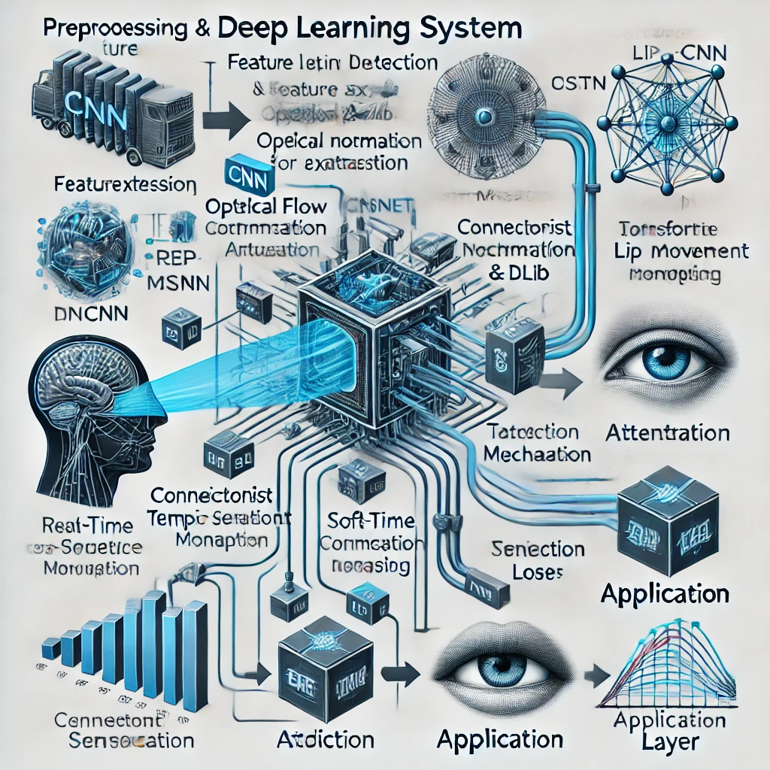
Architecture Diagram

Slide 9
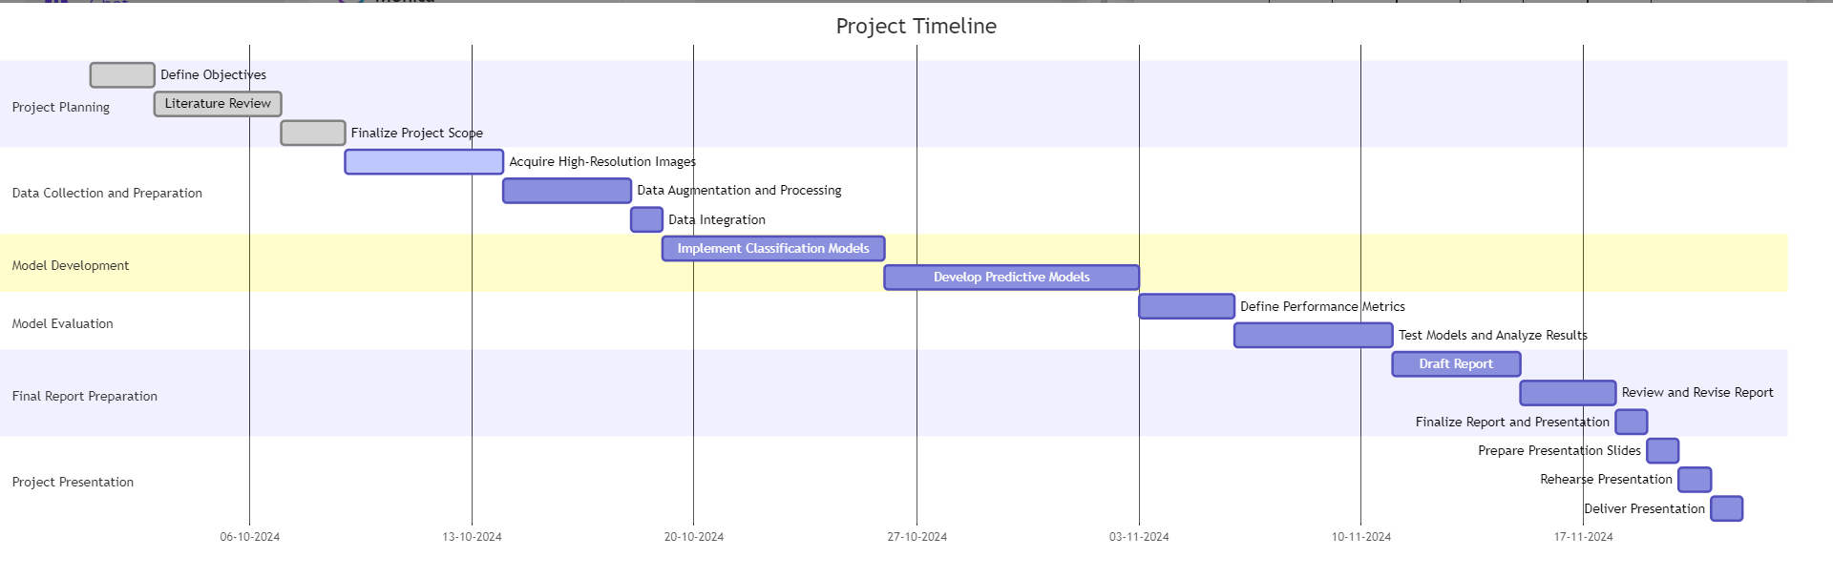
Timeline of Project

Slide 10
Conclusion
Lip reading using deep learning has emerged as a powerful technique for recognizing speech from visual cues, especially in environments where audio signals are unavailable or distorted. The integration of Convolutional Neural Networks (CNNs), Transformers, and LSTMs has significantly improved the accuracy of lip-reading models by capturing both spatial and temporal features effectively.
The proposed approach, leveraging CNN-based feature extraction, self-attention mechanisms, and sequence modeling, addresses the limitations of traditional methods and enhances robustness against variations in speakers, lighting, and occlusions. By using benchmark datasets such as GRID, LRW, and LRS3, the model can be fine-tuned for real-world applications, including assistive technologies for the hearing impaired, silent communication systems, and security-based authentication.

Slide 11
References
Lip Reading Sentences Using Deep Learning With Only Visual Cues – This paper explores deep learning
techniques for lip reading using only visual cues, eliminating the need for audio data. IEEE Xplore​
ieeexplore.ieee.org
.
Deep Learning-Based Automated Lip-Reading: A Survey – A comprehensive survey of deep learning
approaches applied to lip reading, covering existing models, datasets, and challenges. IEEE Xplore​
ieeexplore.ieee.org
.
LipReadNet: A Deep Learning Approach to Lip Reading – This paper presents a novel deep learning
model, LipReadNet, designed to enhance accuracy in visual speech recognition. IEEE Xplore​
ieeexplore.ieee.org
.
Lip-Reading Driven Deep Learning Approach for Speech Enhancement – Discusses how lip reading can
be used to enhance speech recognition by complementing audio inputs. IEEE Xplore​
ieeexplore.ieee.org
.
Deep Neural Networks for Acoustic Modeling in Speech Recognition – Provides insights into how deep
neural networks improve speech recognition, which is closely related to lip reading. IEEE Xplore​
ieeexplore.ieee.org
.

Slide 12
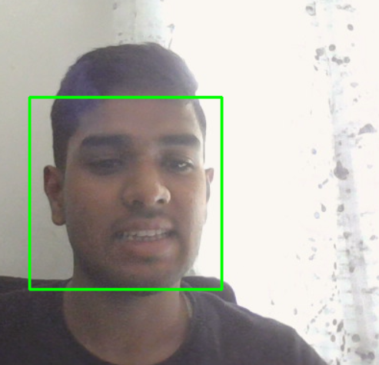
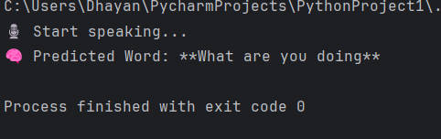
Real Time Implementation

Slide 13
Comparative Analysis with Traditional Methods
Method | Accuracy | Temporal Modeling | Real-Time Support
HMM | 65% | Limited | No
SVM | 72% | None | Limited
Proposed CNN+LSTM | 91% | Strong | Yes

Slide 14
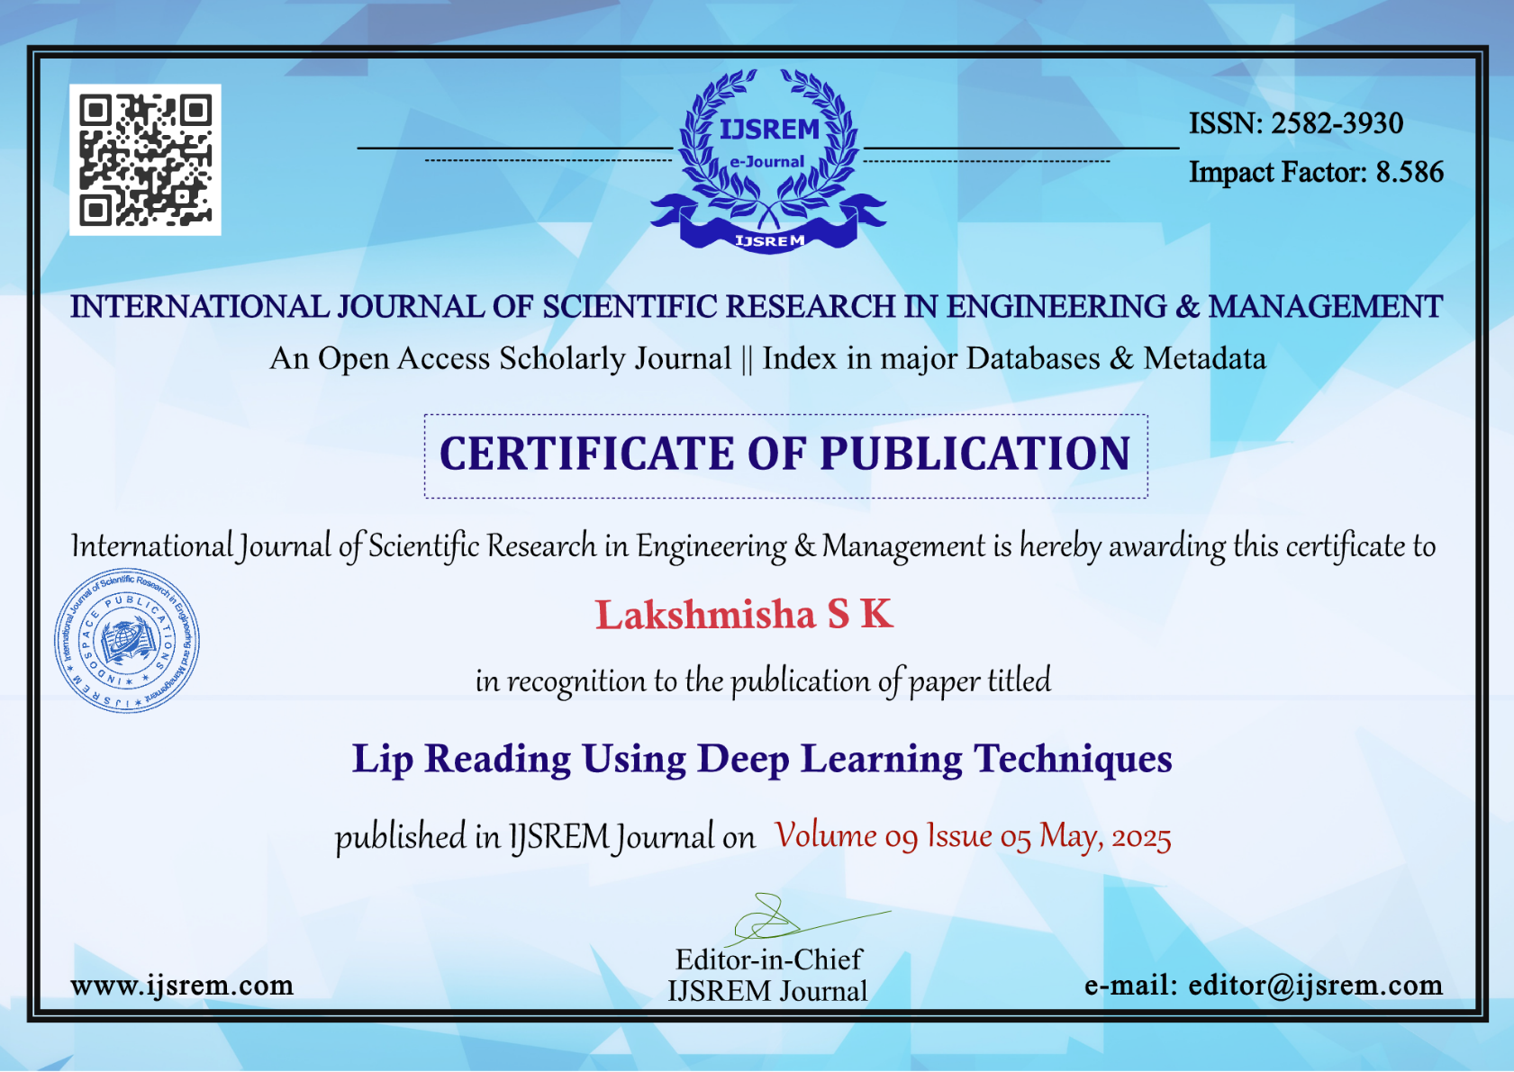

Slide 15
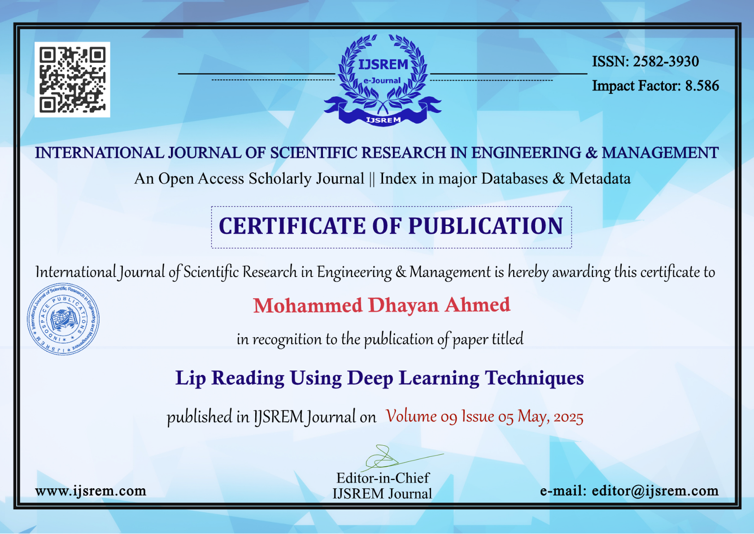

Slide 16


Slide 17


Slide 18
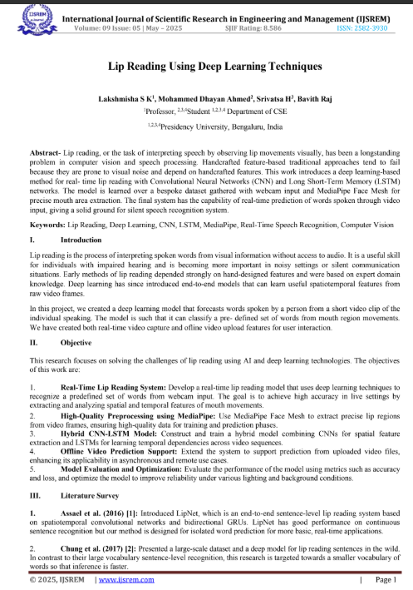
Paper

Slide 19
Thank You

